Slide 1
Welcome

Slide 2
Announcements
February 19th
No Troop meeting President’s Day
February 26th
Patrol Leaders Council

Slide 3
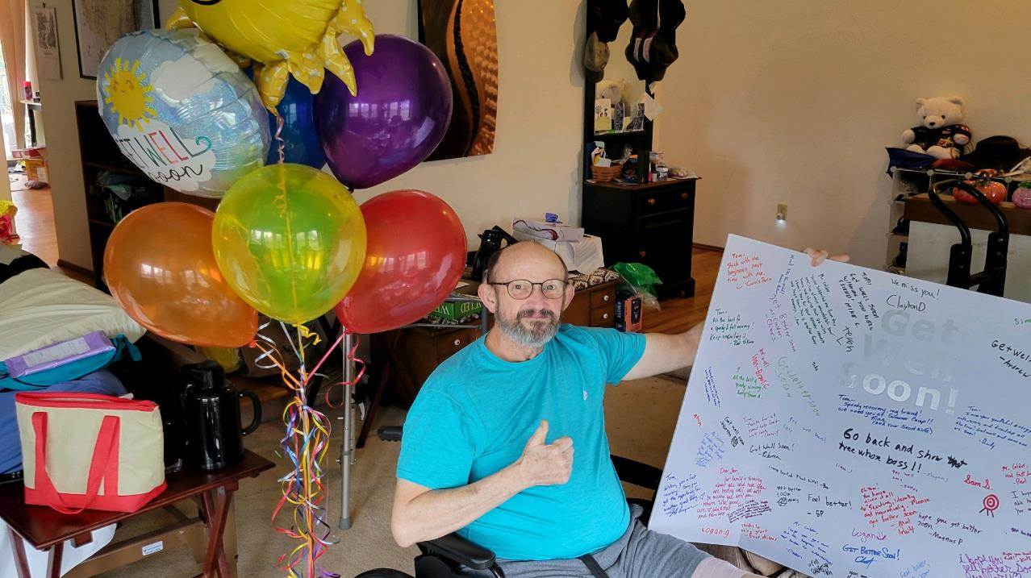
Tom Calder

Slide 4
New Updated Troop Handbook
https://troop570.org/
Click on Other Resources

Slide 5
Registration
YPT: Successfully completed Youth Protection Training at My.Scouting.org by creating a login.
Apply: Submit an online application as a Committee Member using the same login information at https://www.scouting.org/programs/scouts-bsa/ and pay the necessary fees.
Registration includes a background check.
Notify: To inform us that you have an application awaiting approval, send an email to Leah Meigs at Leahjohn1031@gmail.com.
If you plan to attend an upcoming overnight outing, please allow TWO WEEKS for the registration process.

Slide 6
Chartered Organization Representative Updates Scout Sunday February 18th HSLC Service Project March 16th
Mat Pruitt

Slide 7
Senior Patrol Leader Updates
Boys Troop
Scout Profile (troopkit.com)
Ron Delamarter

Slide 8
Senior Patrol Leader Updates Girls Troop
Senior Patrol Leader Updates Girls Troop
Senior Patrol Leader Updates Girls Troop
Senior Patrol Leader Updates Girls Troop
Senior Patrol Leader Updates Girls Troop
Senior Patrol Leader Updates Girls Troop
Senior Patrol Leader Updates Girls Troop
Senior Patrol Leader Updates Girls Troop
Scout Profile (troopkit.com)
Khushi Jain
Scout Profile (troopkit.com)
Khushi Jain

Slide 9
Treasure Update
2023-24 Budget - Troop 570.xlsx - Google Sheets
Girls 23-24 Budget.xlsx - Google Sheets
Justin Neddo

Slide 10
Medical Forms 2024
Rina Klabo

Slide 11
Christmas Tree Recycling update Rina Klabo

Slide 12
Summer Camp 2024
Boys Troop
Camp Parsons
July 28th- August 3rd
Girls Troop
Camp Fire Mountain
July 28th- August 3rd

Slide 13
Reminders:
Sign up for summer camp
Check your Scout Accounts
Turn in your new Medical forms for 2024
Adults: Allow TWO WEEKS for the registration process if you plan to attend and overnight outing.
This Photo by Unknown Author is licensed under CC BY-SA

Slide 14
Questions
Leah Meigs
Committee Chair
Leahjohn1031@gmail.com
206-849-3385

